Slide 1
Project Presentation of CO-OP Project at Industry (Module-2) (22CS421)
On
Money Mentor: A Collaborative Real-Time Personal Finance Management System With Role-Based Access Control and AI-Driven Financial Analytics
Karandeep kaur -2210991750 Bama Charan -2210991436 Aryan Kaushal -2210991382
Himanshu Joshi-2210991660
Supervised By
Prof. Dr. S.B. Goyal
Department of Computer Science and Engineering,
Chitkara University, Punjab

Slide 2
Introduction
Money Mentor is a smart personal finance management system designed to help individuals and families manage their finances efficiently.
It combines features like expense tracking, budgeting, investment monitoring, and bank integration into one unified platform.
The system uses AI-powered analytics and chatbot support to provide personalized financial insights and predictions.
It also introduces a collaborative family hub with role-based access control, enabling multiple users to manage shared expenses in real time.
The goal of this project is to simplify financial management and provide proactive, data-driven financial guidance.
2

Slide 3
Project Overview
What is Money Mentor ?
Money-Mentor is a full-stack FinTech web application that empowers individuals and families to take control of their finances. It combines expense tracking, smart budgeting, real bank-account linking (via Plaid), an AI-powered chatbot (Google Gemini), investment portfolio management, and a collaborative Family Hub - all in one unified platform.
Expense Tracking
• Manual + auto-categorisation
• NLP-based tagging
• Category analytics
Budget Management
• Create per-category budgets
• Adherence alerts
• Multi-period support
Bank Integration
• Plaid API (US & Canada)
• Real-time sync
• Multi-account support
AI Advisory
• Gemini chatbot
• AI Shadow forecasts
• Personalised advice
Investment Tracker
• Stocks, ETFs, crypto…
• Gain/Loss dashboard
• Price alerts
Family Hub
• Shared expenses
• Role-based access
• Real-time via WebSocket

Slide 4
Problem Definition
The financial management gap we set out to close
Fragmented Tools
Manual & Error-Prone Entry
No Family Collaboration
People juggle spreadsheets, multiple apps, and paper notes to track finances — leading to incomplete pictures and missed insights.
Existing apps focus on individuals. Families lack a unified space to track shared expenses, split bills fairly, and set common savings goals.
Manual expense logging is tedious; transactions from different bank accounts are siloed and never automatically categorised.
Reactive, Not Proactive
Lack of AI-Driven Guidance
Investment Blind Spots
Retail investors track investments in isolated broker portals with no holistic view of overall portfolio performance or risk.
Users discover budget overruns only after the fact. No system warns them early or forecasts future shortfalls based on spending patterns.
Most people receive generic financial tips. There is no personalised advisor that factors in real spending history, income, goals, and life stage.

Slide 5
Project Scope
IN SCOPE
• User authentication with OTP email verification
• Personal expense tracking with auto NLP categorisation
• Per-category budget creation & adherence monitoring
• Bank account linking via Plaid API (US & Canada markets)
• Real-time bank transaction sync and auto-categorisation
• Investment portfolio tracking (stocks, ETFs, crypto, bonds, real estate)
• Financial goal setting and progress tracking
• Family hub: shared expenses, fair-split calculation, role management
• Real-time notifications via WebSocket (Socket.io)
• AI chatbot powered by Google Gemini for financial Q&A
• AI Shadow dashboard: spending forecasts and shortfall alerts
• Personalised insurance policy recommendations
• Financial health score computation
• Transaction export (CSV) and reporting
OUT OF SCOPE
• Direct payment processing or money transfers
• Tax filing or accounting compliance features
• Support for markets outside US & Canada (Plaid constraint)
• Native mobile apps (iOS / Android) — web only
• Credit-score integration or loan origination
• Full robo-advisory or automated trading
• Multi-currency real-time conversion engine
• Regulatory compliance (PCI-DSS, GDPR full certification)

Slide 6
Objectives
Goals we aimed to achieve with Money-Mentor
Unified Finance Dashboard
Seamless Bank Integration
Implement Plaid OAuth flow to let users securely link real bank accounts and auto-sync transactions without manual entry.
Build a single-page dashboard aggregating expenses, budgets, investments, goals, and bank balances in one view.
AI-Powered Personalisation
Predictive Analytics
Leverage Google Gemini to provide a conversational chatbot and data-driven financial advice tailored to each user's spending profile.
Deploy an AI Shadow engine that forecasts month-end spending, flags potential shortfalls, and highlights abnormal spending patterns.
Collaborative Family Finance
Comprehensive Investment Tracking
Enable multi-user family groups with role-based access, shared expense splitting, and real-time updates via WebSocket.
Provide a portfolio tracker across asset classes with live performance metrics, gain/loss computation, and configurable price alerts.
Holistic Financial Health
Secure & Scalable Architecture
Compute a dynamic Financial Health Score reflecting savings rate, budget adherence, debt ratio, and goal progress.
Design a JWT-authenticated REST API on Node/Express backed by MongoDB Atlas, deployed on Render + Vercel with Cloudflare Workers for edge compute.

Slide 7
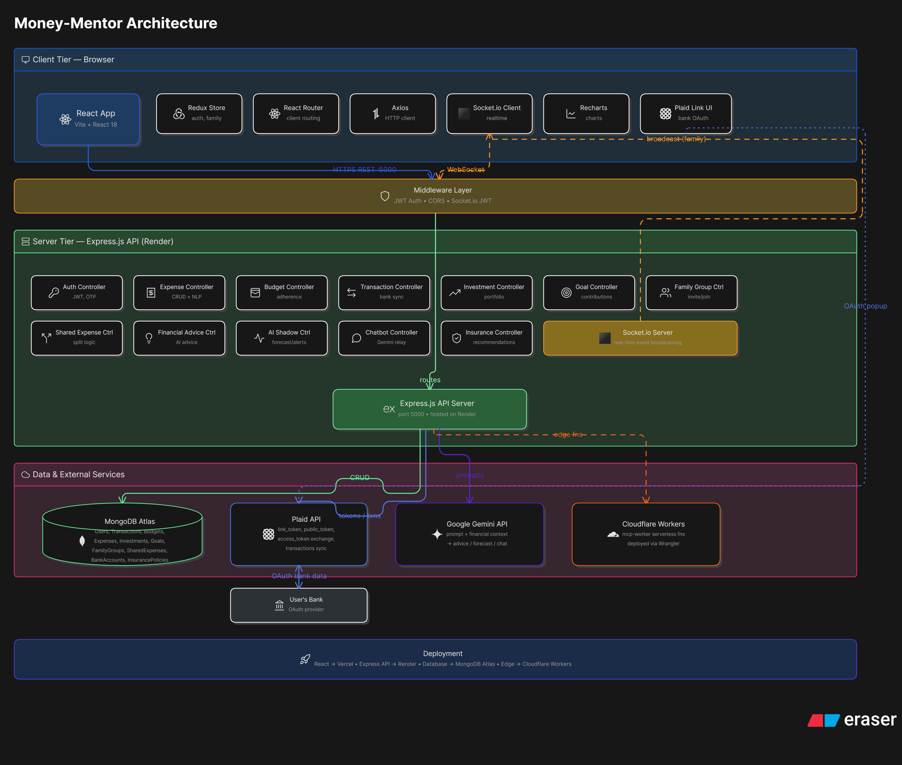
System Architecture

Slide 8
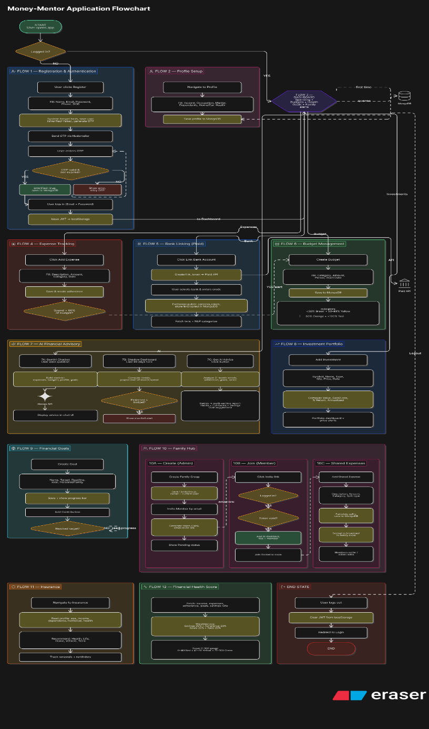
User Workflow Diagram

Slide 9
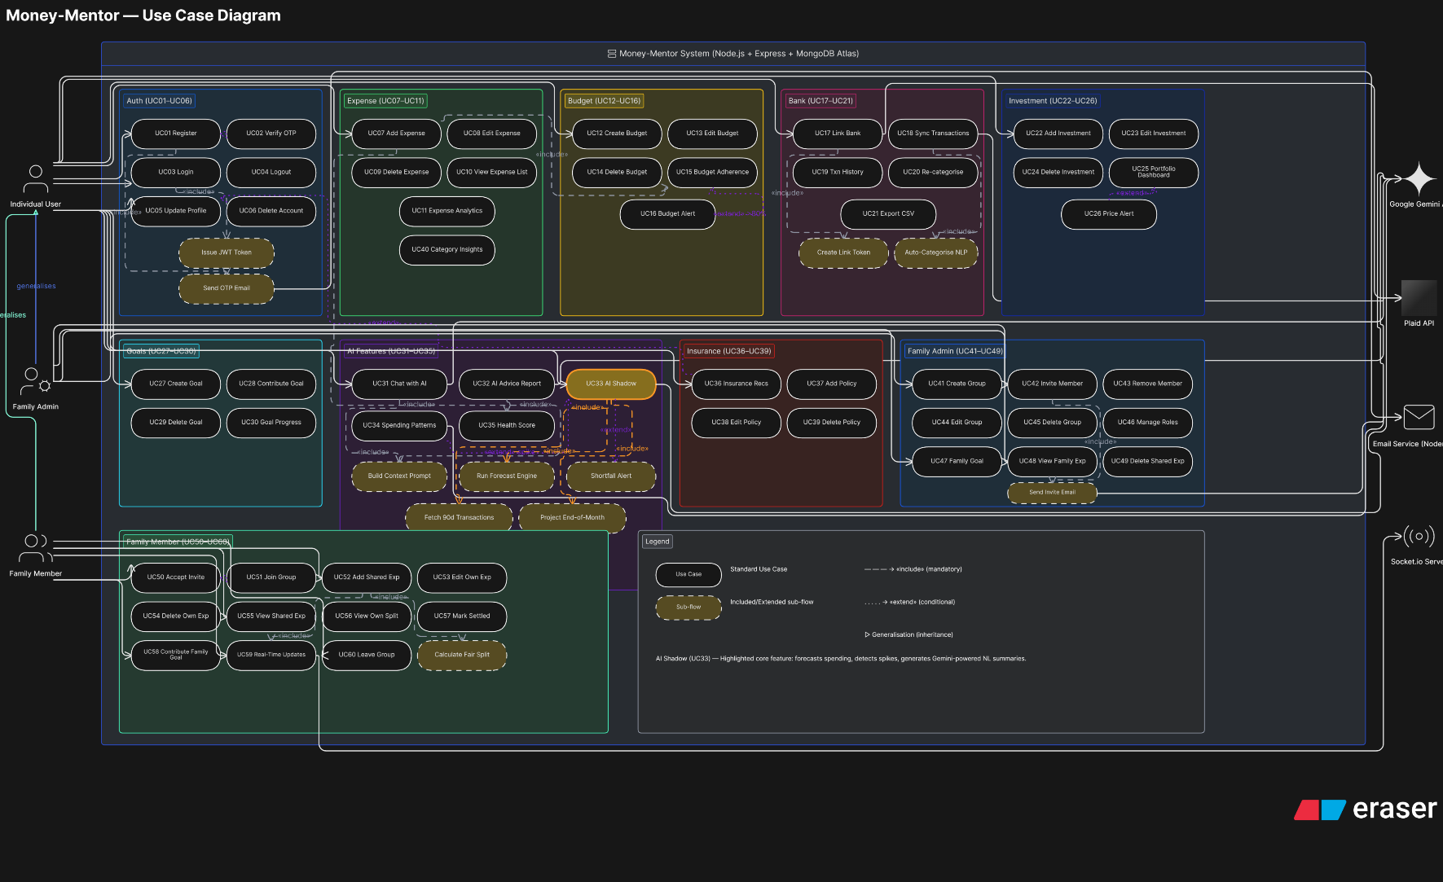
Use-Case Diagram

Slide 10
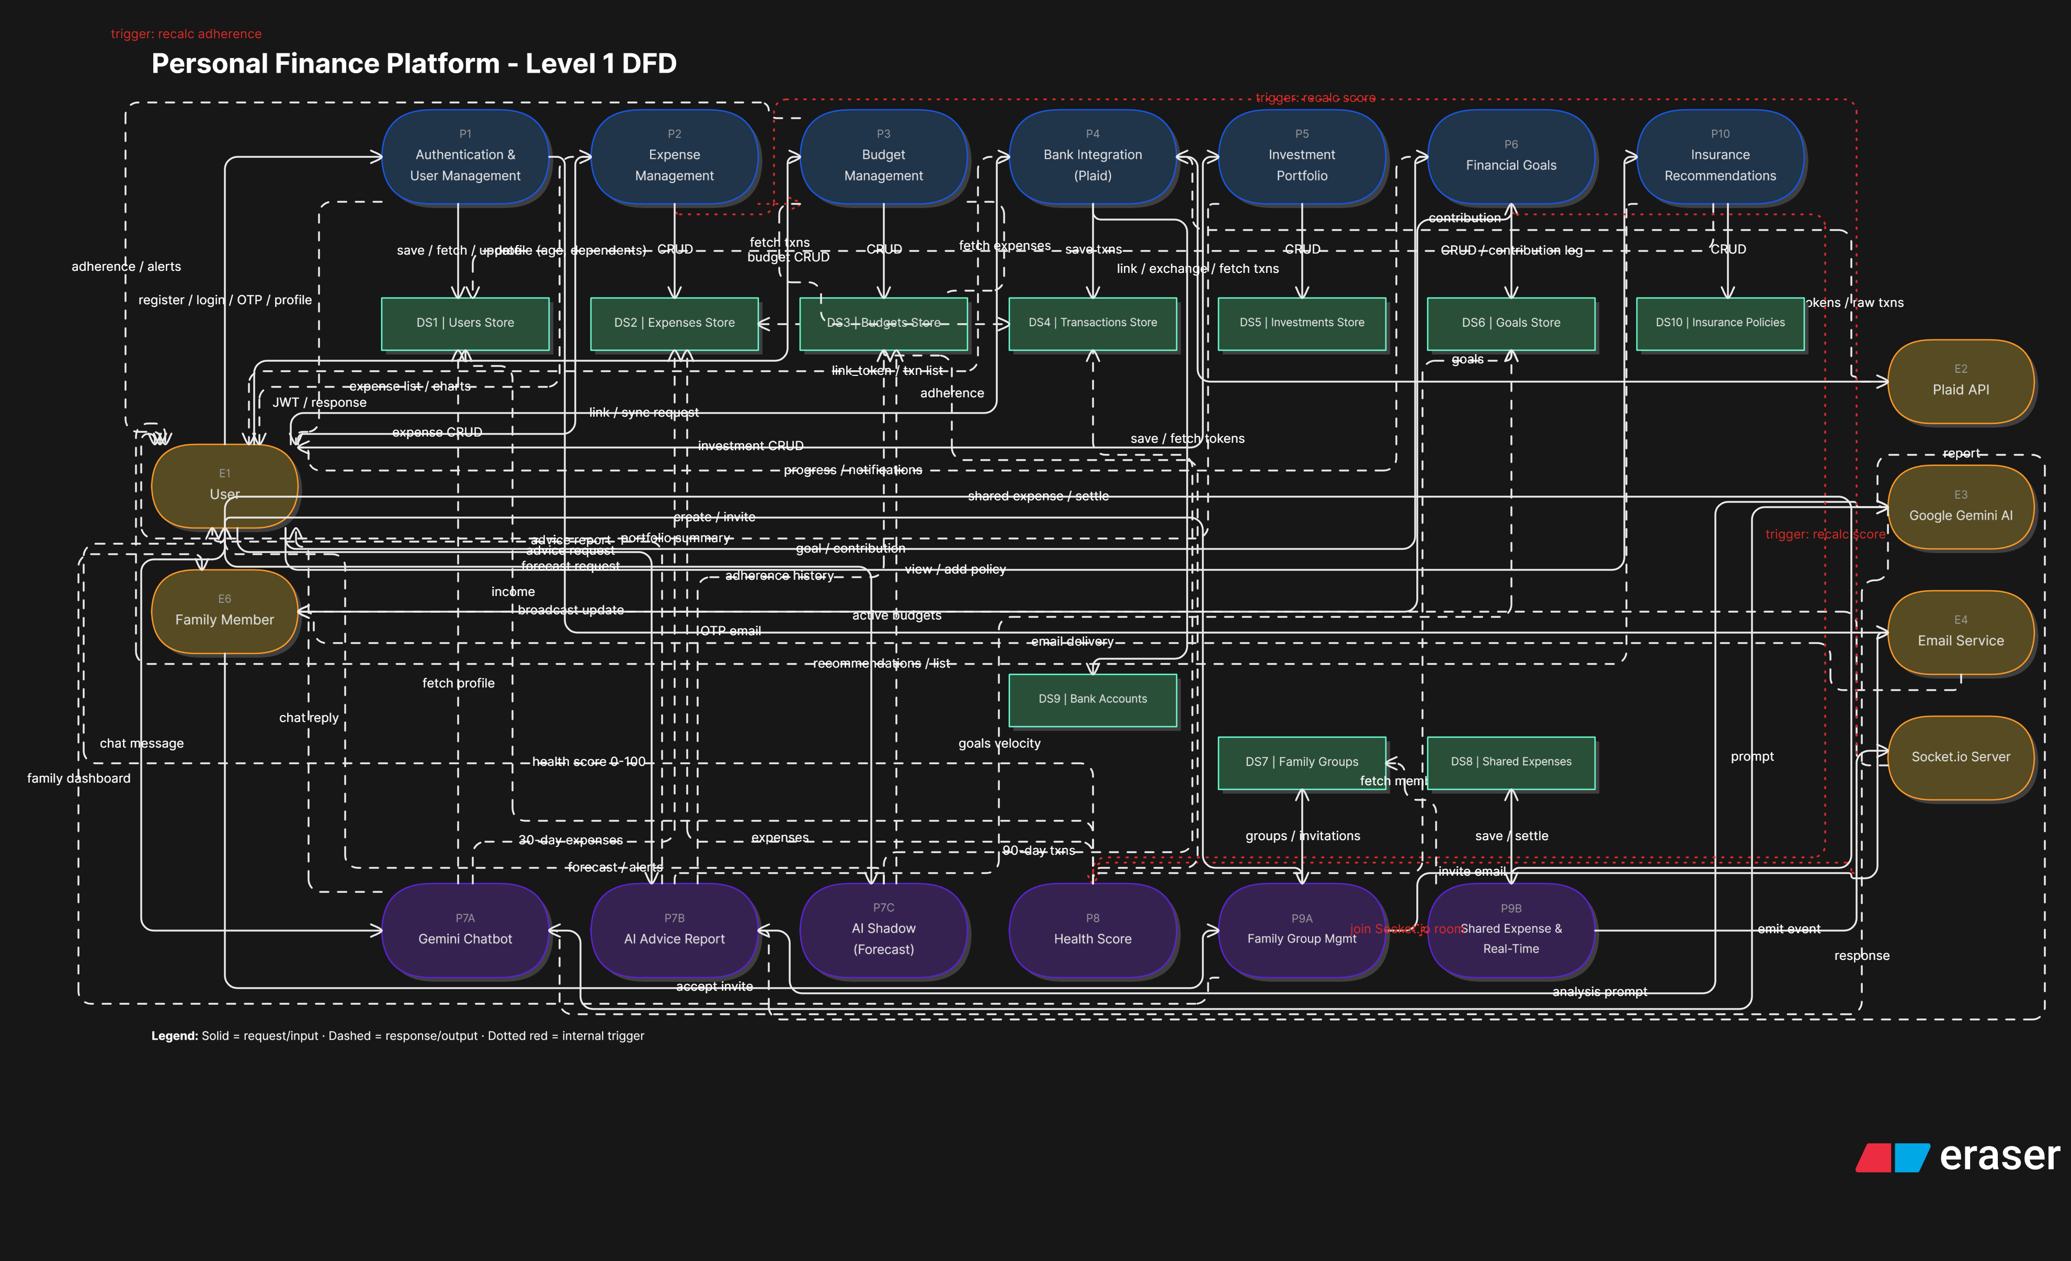
Data Flow Diagram

Slide 11
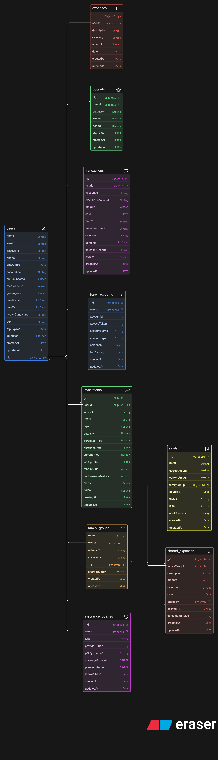
Database Schema

Slide 12
Tools and Technologies
Frontend
Backend
Database & Storage
AI & ML
▸ React.js 18.3
▸ Node.js
▸ MongoDB Atlas (Cloud)
▸ Google Gemini 1.5 Flash
▸ Vite 5.4
▸ Express.js 4.19
▸ Mongoose ODM
▸ @google/generative-ai 0.17
▸ Tailwind CSS 3.4
▸ Mongoose 8.5
▸ 12 collections
▸ Gemini Chatbot Q&A
▸ Redux Toolkit 2.2
▸ Socket.io Server 4.8
▸ GridFS (future)
▸ AI Shadow Forecasting
▸ React Router 6
▸ JWT (jsonwebtoken)
▸ NLP Transaction Tagging
▸ Recharts 2.14
▸ Bcryptjs 5.1
▸ Socket.io Client 4.8
▸ Nodemailer 6.9
▸ Axios 1.7
▸ Zod 4.3
▸ Flowbite React
▸ Natural 8.0 (NLP)
▸ Lucide Icons
▸ json2csv
External APIs
DevOps & Deployment
Auth & Security
Real-Time
▸ Plaid API v30 (bank link)
▸ Vercel (frontend)
▸ JWT tokens
▸ Socket.io WebSocket
▸ Plaid Sandbox / Production
▸ Render (backend)
▸ Bcrypt password hashing
▸ JWT-authenticated sockets
▸ Google Generative AI
▸ Cloudflare Wrangler
▸ CORS middleware
▸ Rooms per family group
▸ Cloudflare Workers (edge)
▸ Nodemon (dev)
▸ OTP via Node mailer
▸ Live expense broadcast
▸ ESLint
▸ Socket.io JWT middleware

Slide 13
Key Features
Plaid Bank Integration
AI Financial Advisory
Secure OAuth link via Plaid Link UI
Gemini 1.5 Flash powers real-time chat
Fetches real transactions from 11,000+ US/CA banks
Context-aware: knows user's income, expenses, goals
Auto-syncs and categorises on-demand
AI Shadow predicts month-end spending per category
Stores access tokens encrypted in MongoDB
Flags shortfalls 2+ weeks before end-of-month
Supports checking, savings, credit accounts
Generates written advice reports on demand
Family Hub
Investment Tracker
Admin creates group; invites via tokenised email link
Supports stocks, ETFs, bonds, mutual funds, crypto
Members can add shared expenses (e.g., rent, groceries)
Tracks purchase price, quantity → computes gain/loss
Auto-calculates fair splits among members
Stores P/E ratio, dividend yield, 52-week hi/low
Real-time updates pushed via Socket.io rooms
Configurable price alerts (above/below thresholds)
Collaborative savings goals with contribution tracking
Annualised return & volatility metrics

Slide 14
Outcomes
50+
12
40+
7
4
3
REST API Endpoints
React Components
Real-Time Features
Deployment Platforms
MongoDB Collections
AI-Powered Services
Functional Product
AI Integration
Real-Time Collaboration
Security & Auth
• Production-deployed on Vercel + Render
• Google Gemini chatbot integrated end-to-end
• Socket.io enables sub-second family expense updates
• OTP email verification for all new accounts
• Live URL: money-mentor-wheat.vercel.app
• AI Shadow engine provides 30-day spending forecasts
• Bcrypt password hashing (cost factor 12)
• JWT-authenticated WebSocket rooms per family group`
• Full CRUD operations across all modules
• JWT tokens with expiry and refresh strategy
• NLP auto-categorises 90%+ of bank transactions
• End-to-end tested with sandbox bank data
• Email invite flow with secure time-limited tokens
• CORS restricted to known frontend origins
• Personalised advice adapts to user financial profile
• Concurrent multi-user family expense management

Slide 15
Learnings
Third-Party API Complexity
Prompt Engineering for Finance
Plaid's sandbox/production differences, token management, and error handling required careful design. We learned the importance of abstraction layers (plaidService.js) to decouple external API changes from business logic.
Crafting effective Gemini prompts required iterating on context injection — passing spending summaries, budgets, and goals so the AI produces actionable, personalised advice rather than generic responses.
Real-Time Architecture
NLP for Categorisation
Socket.io room-based broadcasting required careful authentication middleware. We learned JWT validation for WebSocket upgrade requests and the nuances of managing disconnects and reconnects gracefully.
The 'natural' library's tokenisation and TF-IDF worked well for structured merchant names but struggled with ambiguous descriptions, teaching us the limits of rule-based NLP vs. ML approaches.
Monorepo Structure
Security Best Practices
Implementing OTP verification, bcrypt hashing, and JWT middleware from scratch deepened our understanding of auth flows, token expiry, and securing WebSocket connections — often overlooked in tutorials.
Maintaining client/ and server/ in one repo improved DX significantly. We learned the value of shared type contracts between frontend API calls and backend response shapes to reduce integration bugs.
State Management at Scale
Deployment & DevOps
Configuring Vercel for SPA routing managing CORS between Render and Vercel origins, and using Cloudflare Wrangler for edge workers gave us hands-on production deployment experience.
As the app grew, prop-drilling became painful. Migrating to Redux Toolkit with slice-based state (authSlice, familySlice) taught us when global state is warranted vs. local component state.

Slide 16
Future Goals
Phase 1 (0–3 months)
Phase 2 (3–6 months)
Phase 3 (6–12 months)
Long-Term (12+ months)
▸ Native iOS & Android apps (React Native)
▸ Credit score integration (Experian / Equifax API)
▸ Full robo-advisor with automated rebalancing
▸ Open Banking API marketplace for 3rd-party plugins
▸ Multi-currency support with live exchange rates
▸ Robo-advisory: AI-generated investment recommendations
▸ Peer-to-peer money transfers within Family Hub
▸ AI portfolio manager with market sentiment analysis
▸ Dark/light theme with accessibility improvements
▸ Tax estimation module (US 1040 / Schedule C)
▸ Machine learning-based fraud detection on transactions
▸ Blockchain-based audit trail for family finances
▸ Transaction search and advanced filters
▸ Bill & subscription management with reminders
▸ Compliance: SOC 2, PCI-DSS level 1 certification
▸ Enterprise family office management features
▸ Recurring expense & subscription detection
▸ Plaid expansion: UK, EU markets (Open Banking)
▸ B2B SaaS offering for small business accounting
▸ IPO / acquisition readiness with due-diligence pack

Slide 17
Thank You
17

